Slide 1
Rain Gardens on Pinterest
Jessica Fulgoni
Ashlee Haviland

Slide 2
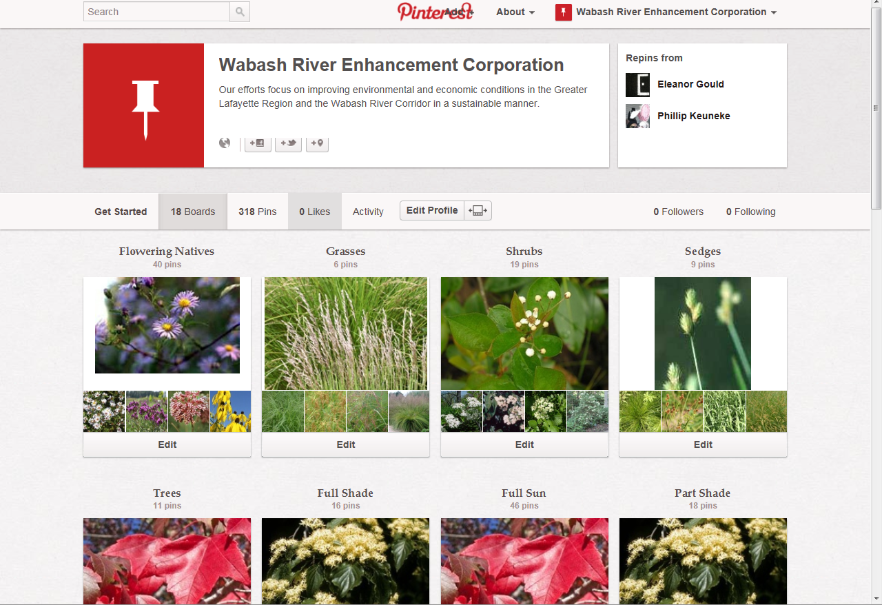

Slide 3
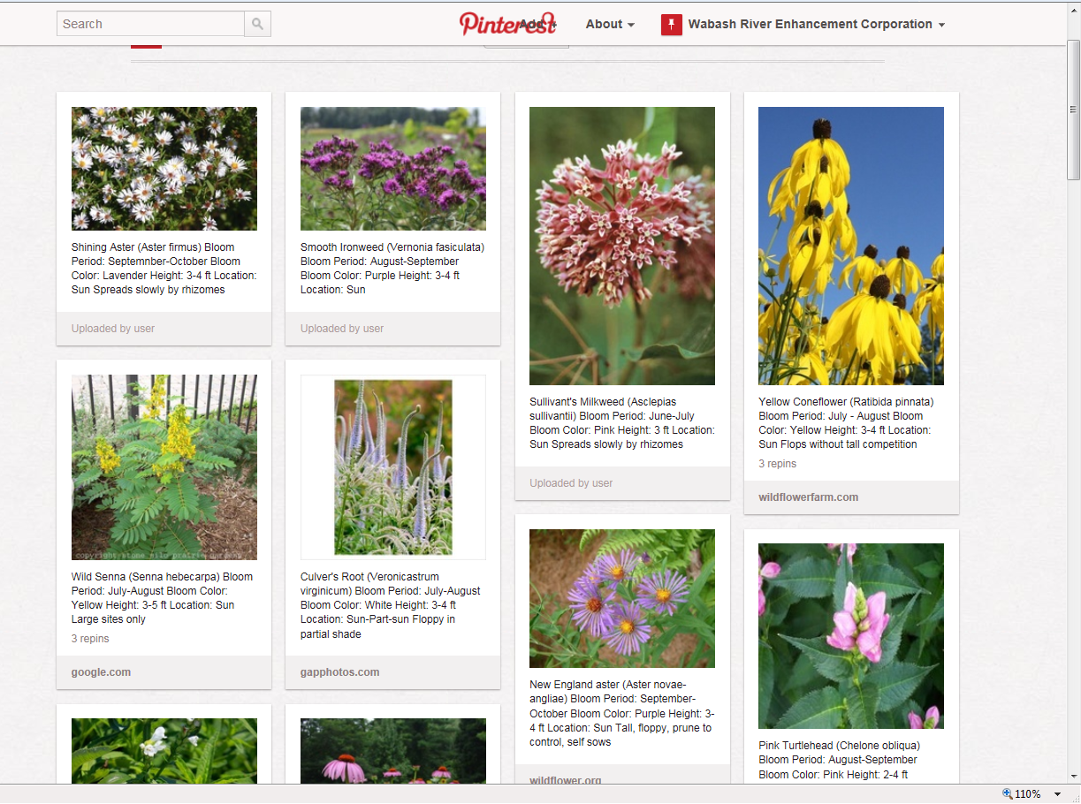

Slide 4
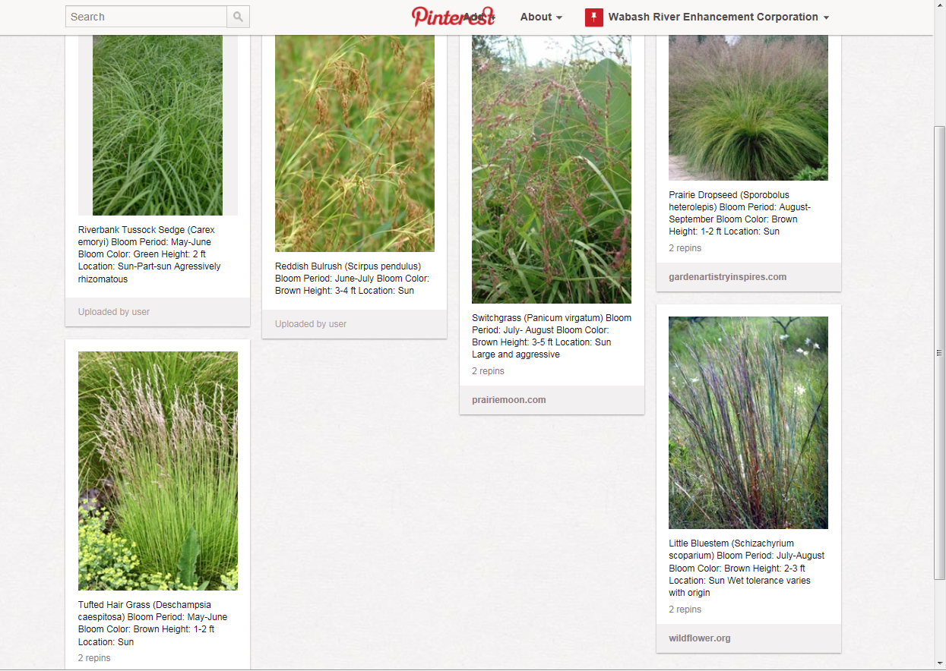

Slide 5
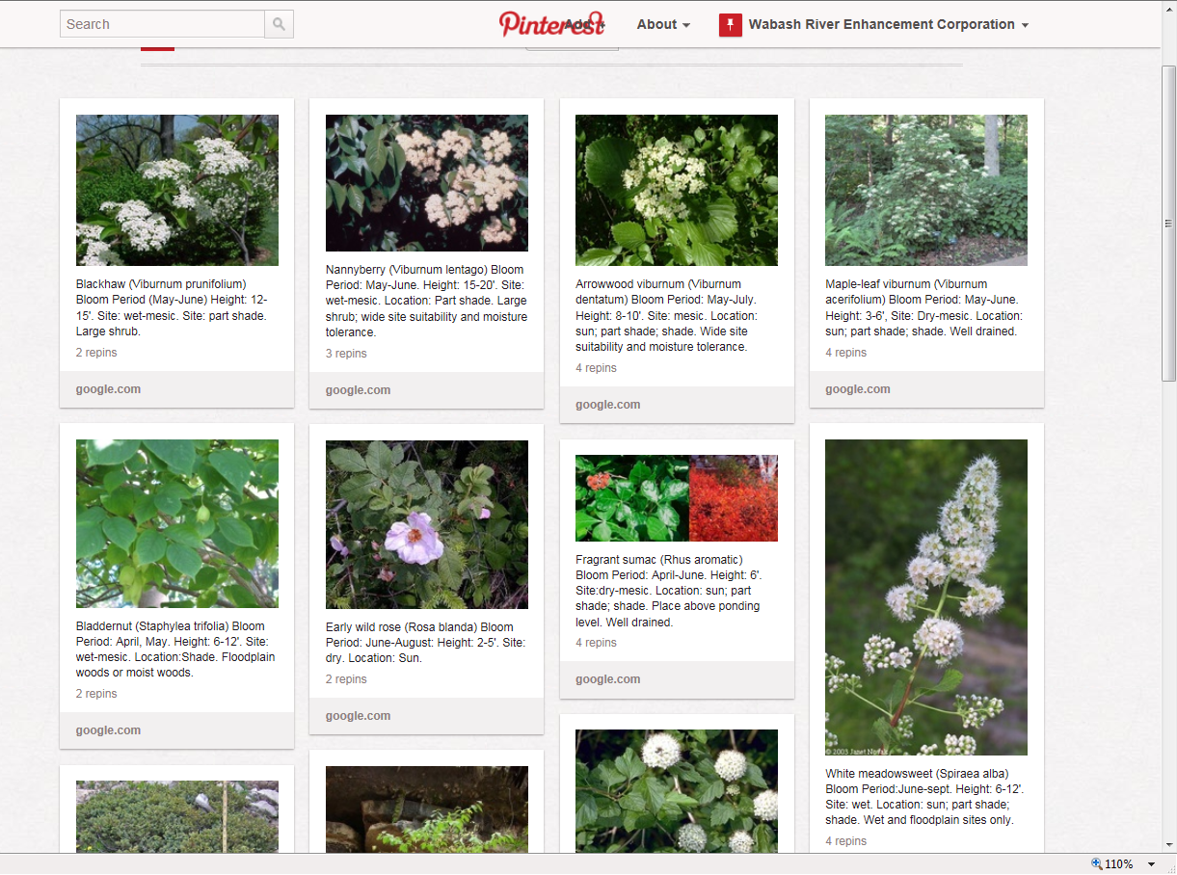

Slide 6
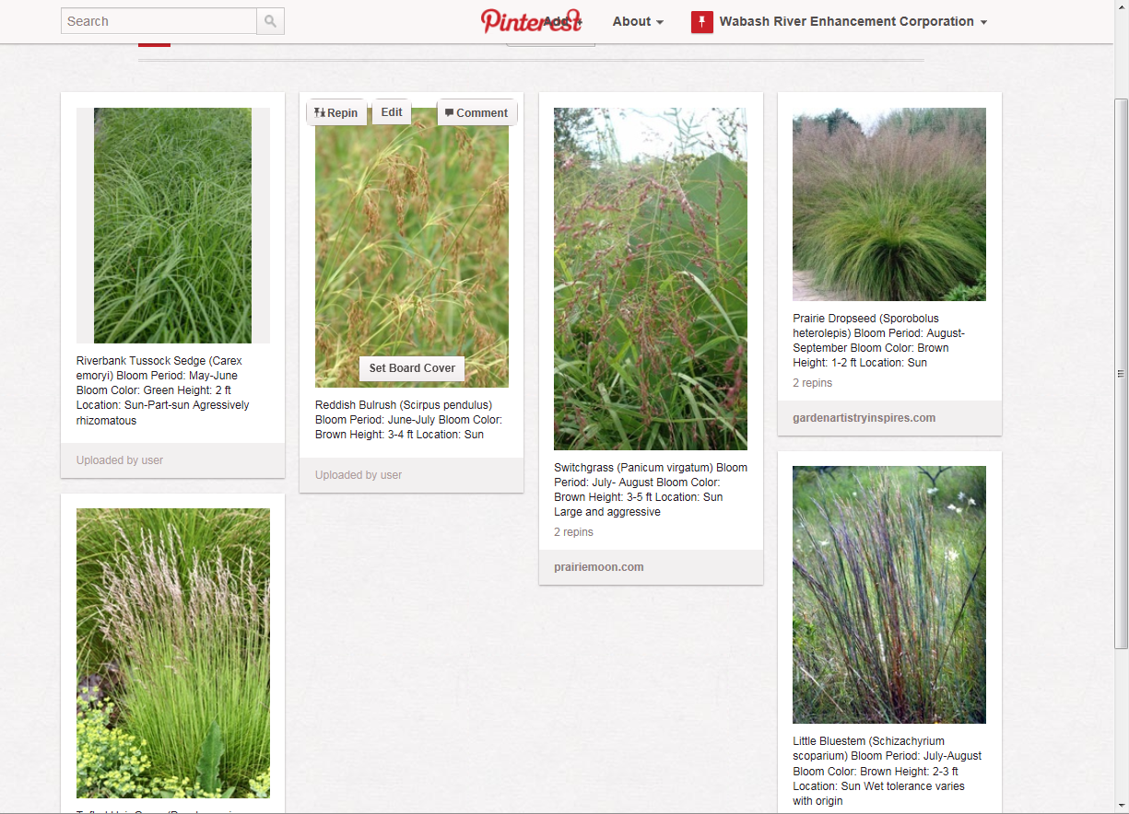

Slide 7
